Slide 1
BRITISH AIRWAYS
Web scraping to gain company insights
Scrape and analyze customer review data to uncover findings for British Airways

Slide 2
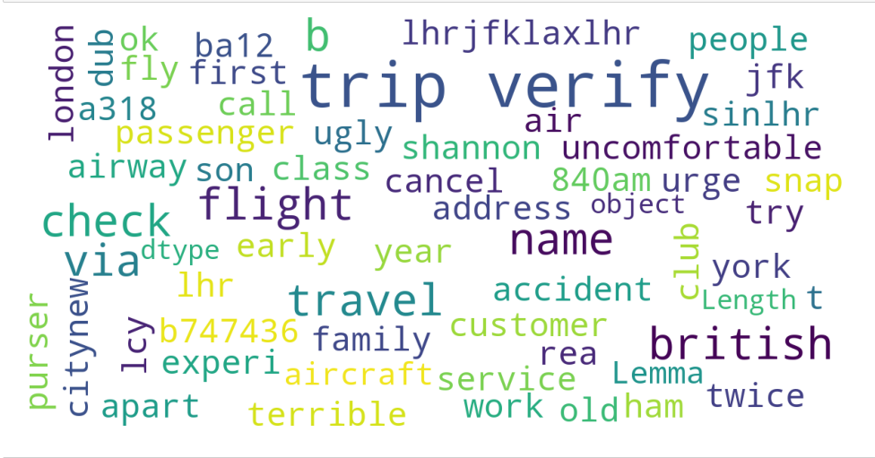
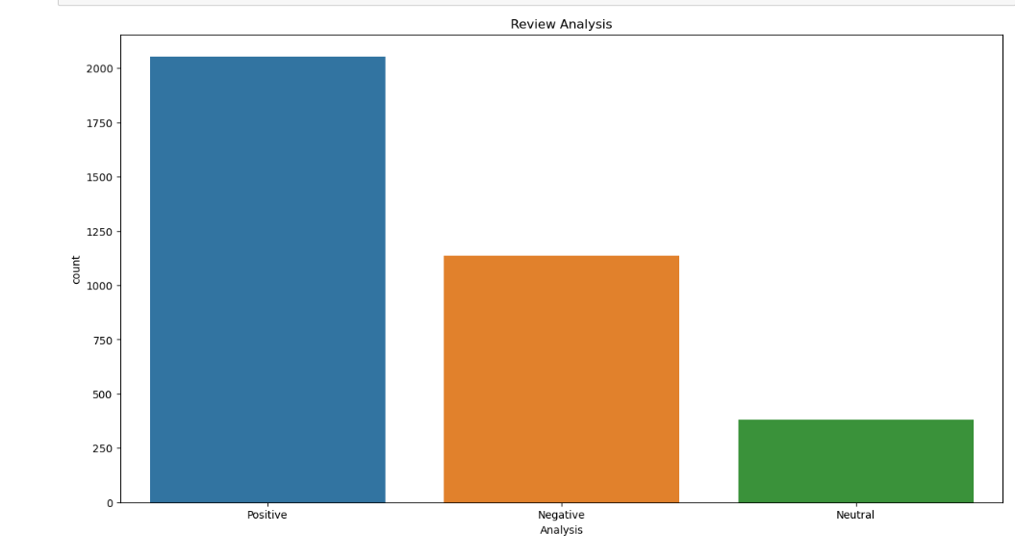
INSIGHTS FROM CUSTOMER REVIEW Scrapped 100 pages of data with 3572 reviews. Positive reviews :2053 Negative reviews: 1137 Neutral reviews:382

